Slide 1
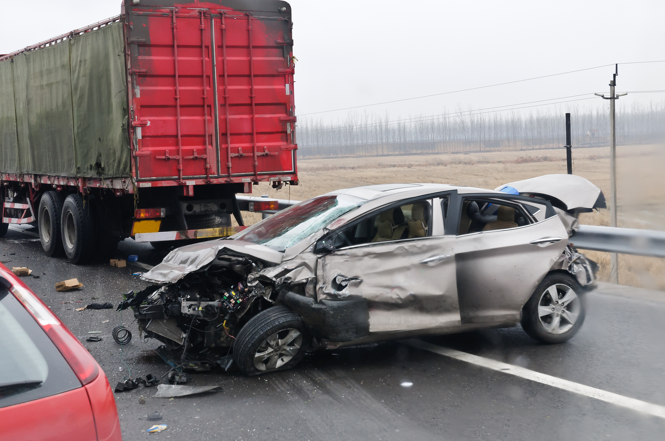
OKLAHOMA STATE UNIVERSITY
Predicting Driver Injury Severity in Passenger Vehicle Crashes
Ritwick Dhibar
Bhargavi Gatti
Indu Sen
Somunath Reddy Sirasanambeti
1

Slide 2




Team Info
Ritwick Dhibar
MS, Management
Information Systems
Bhargavi Gatti
MS, Management
Information Systems
Indu Sen
MS, Business Analytics
and Data Science
Somunath Reddy
Sirasanambeti
MS, Management
Information Systems
2

Slide 3
Agenda
1) Analysis Methodology Overview
4) Data Preparation
2) Business Understanding
5) Modeling
6) Evaluation
7) Deployment
8) Conclusion + Summary
3) Data Understanding
3

Slide 4

Analysis Methodology Overview​
4
4

Slide 5

BUSINESS UNDERSTANDING

Slide 6
Problem Understanding
46,000 fatalities in 2022 (NSC).
Death rate rising since 2019.
$1.85 trillion in crash-related societal costs (TRIP 2023).
Importance: Predict injury outcomes to guide safety strategies and policy.
​
6

Slide 7

DATA UNDERSTANDING

Slide 8

Data Overview
Source: Crash Report Sampling System (CRSS).
4 datasets: Accident, Vehicle, Person, Distract.
54,200 crashes, 133,734 persons, 95,785 vehicles.
Merged using CASENUM, VEH_NO, PER_NO.
​
8

Slide 9



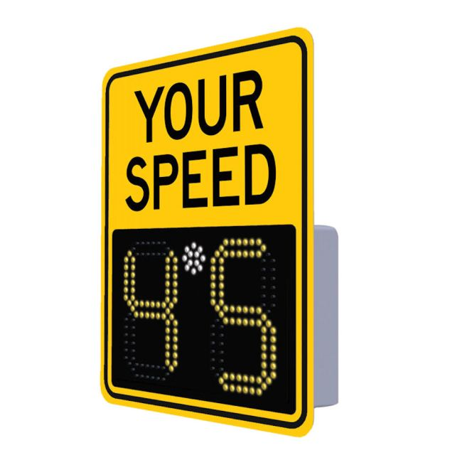
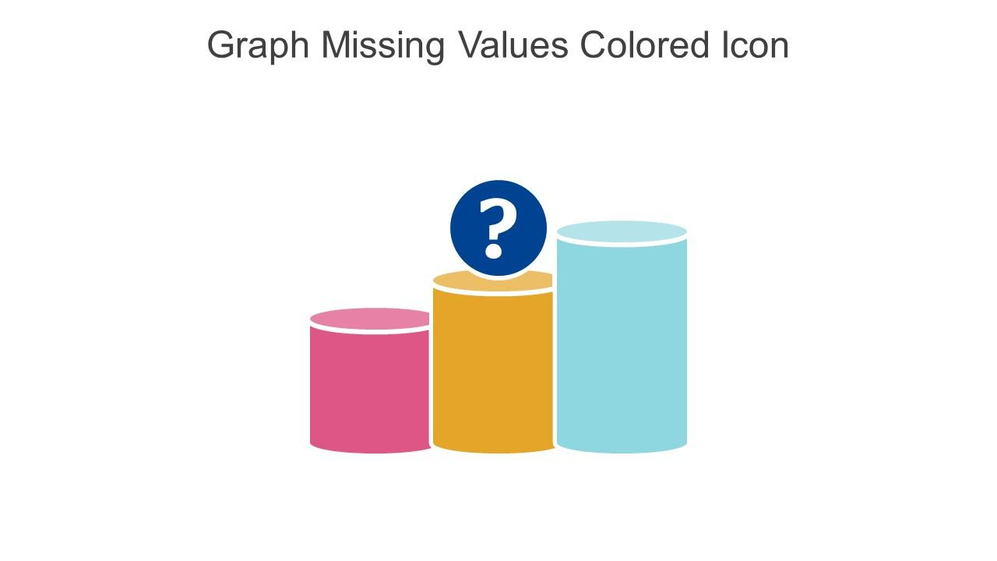
Data Exploration Highlights
Driver Age: Skewed 20–40 years.
Speed Limits: Clustered around 25, 35, 55 mph.
Weather: Majority clear and daylight.
Identified missing values and coding inconsistencies.
9
9

Slide 10
Data Challenges
High missingness in travel speed, maneuver type, airbag deployment.
Categorical variables encoded with special codes (-1, 99, etc.).
Class imbalance: Minor injuries dominate.
Solutions planned: Imputation, flagging, re-encoding, sampling.
10

Slide 11

DATA PREPARATION

Slide 12
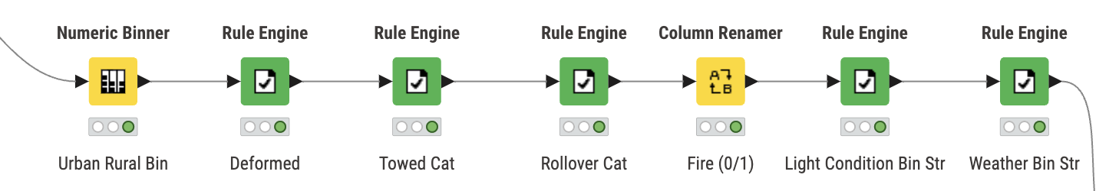
Feature Engineering
Bin Numerical Features: Grouped continuous variables like Light Conditions into categorical bins (e.g., Dawn, Dusk, Dark) to simplify patterns.
Grouping Rare Categories: Combined infrequent categories in nominal variables (e.g., rare vehicle types, unusual weather conditions) to avoid sparse one-hot encoded matrices.
Creating New Features: Engineered meaningful derived variables, such as Season Bins from Month, to capture seasonality effects on crash severity.
Handling Special Codes:
Treated coded unknowns (like 99 = Unknown) as missing to improve feature quality.
Ensuring Model Compatibility: Ensured all engineered features were either numerical or properly one-hot encoded to suit machine learning algorithms.
Excerpt of the Feature Engineering Pipeline
12
13

Slide 13







Cleaning, Transformation & Features’ Preparations
Missing and Duplicated Values Check
Categorical Variables Encoding
Checked for missing values and unknown coded values (e.g., "99" or "-1") and confirmed no critical missing data. Duplicates were not present in the dataset
Categorical variables were transformed using One-Hot Encoding to ensure compatibility with machine learning algorithms that require numerical input.
Outliers Handlings
Data Partitoning
Extreme outliers in numerical features were analyzed; outliers were retained if they were valid real-world scenarios. No artificial capping or removal was performed.
The dataset was partitioned into two sets: 70% for training the models and 30% for testing. Stratified sampling was used to maintain the class distribution across both sets.
Variables Removals
Features’ Scaling
Removed irrelevant columns such as unique IDs or columns with high missing/unknown percentages (> 80%). Columns not useful for modeling were excluded.
Numerical features were standardized to have a mean of 0 and a standard deviation of 1 to improve model convergence and performance, especially for distance-based algorithms.
13
14

Slide 14
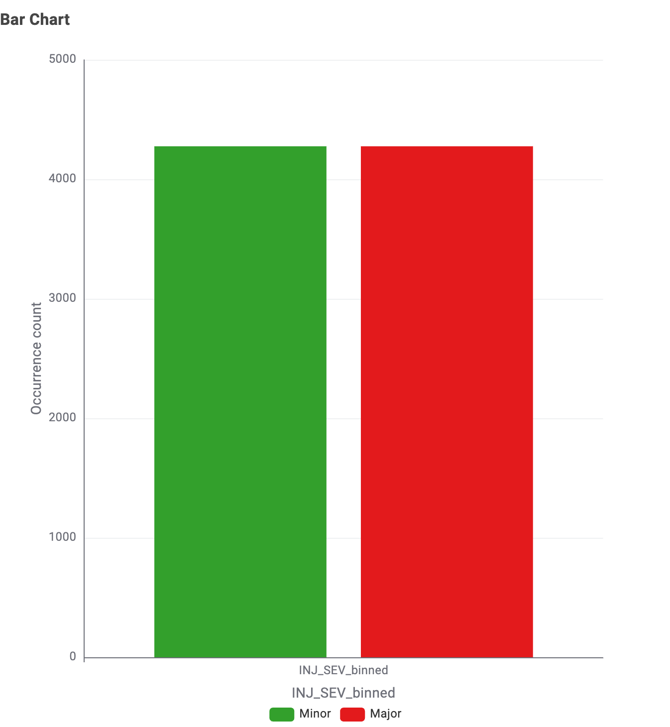
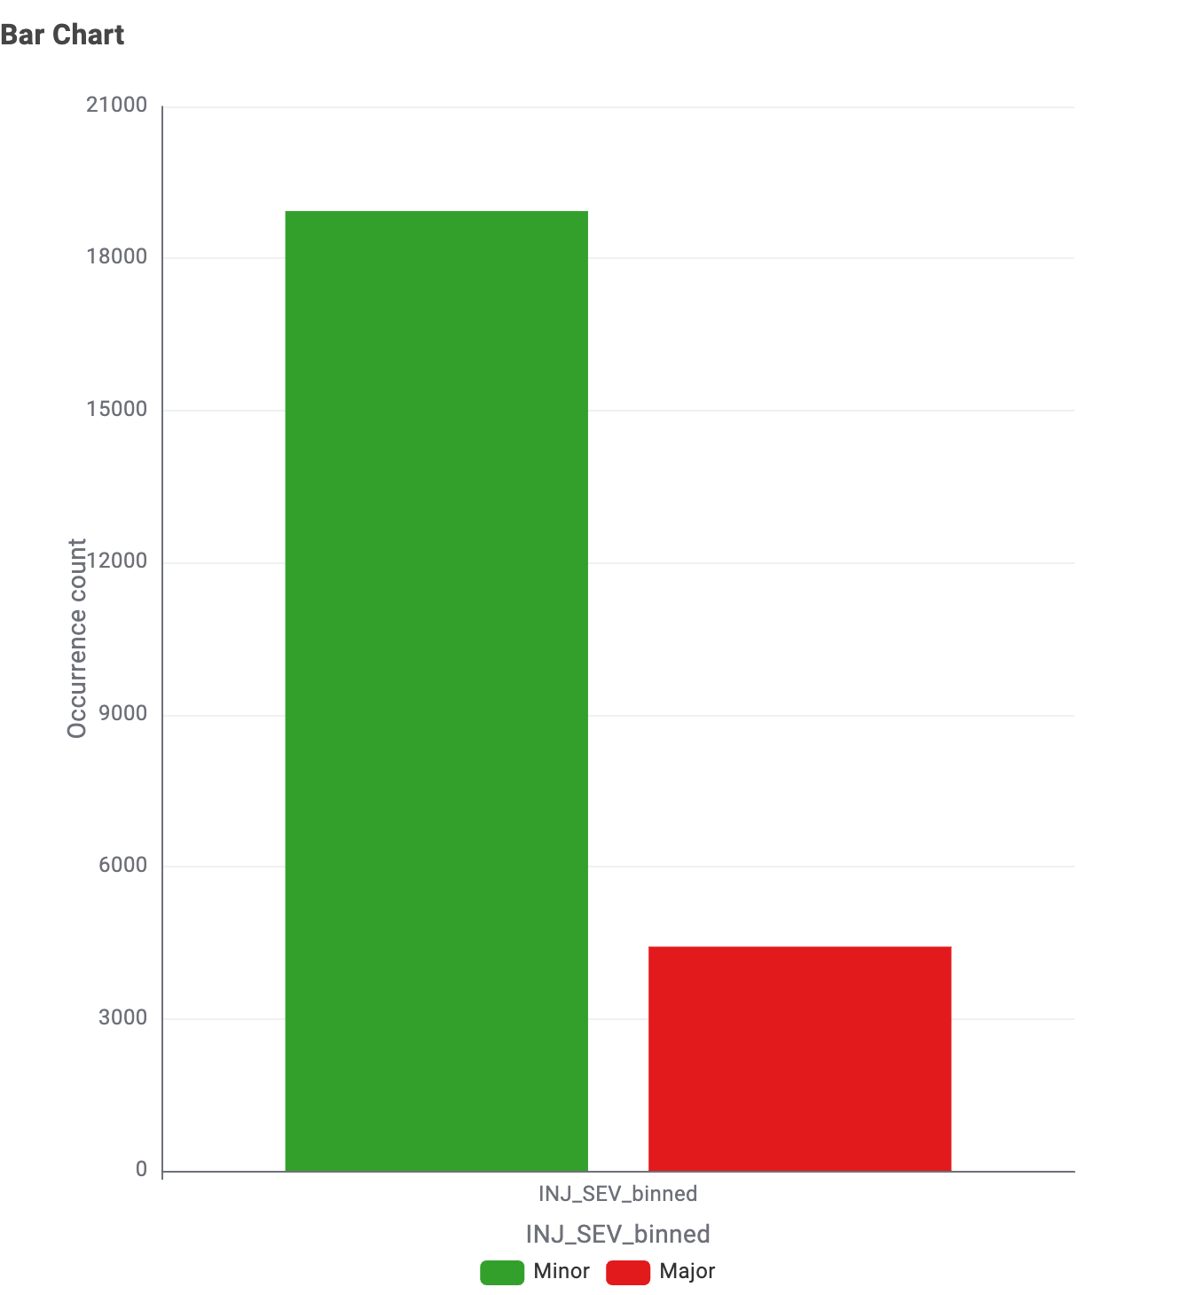
Balancing the Data
"Minor" injuries were much more frequent than "Major" injuries.
Applied Equal Size Sampling to randomly undersample the majority class ("Minor") until both classes had approximately the same number of records.
This corrected imbalance and ensured the model does not get biased toward the dominant class.
Before Equal Size Sampling
After Equal Size Sampling
14
12

Slide 15

MODELING

Slide 16




PREDICTION MODELS
SET BASED
NUMBER BASED
LOGISTIC REGRESSION
MULTILAYER PERCEPTION
K-NEAREST NEIGHBOR
GRADIENT BOOSTING
DECISION TREE
RANDOM FOREST
16

Slide 17


SET BASED MODELS
Easy to understand and good for simple classification problems.
DECISION TREE
Strong and reliable, works well with complex data.
RANDOM FOREST
17

Slide 18

NUMBER BASED MODELS
MLP
Powerful for complex patterns but needs tuning.
Logistic Regression
A method that predicts the chance of an outcome, often used for yes/no decisions.
A method that classifies a data point based on the most common category among its closest neighbors.
K-Nearest Neighbor
Gradient Boosting
A powerful method that builds multiple models sequentially, each correcting the mistakes of the previous one.
18

Slide 19
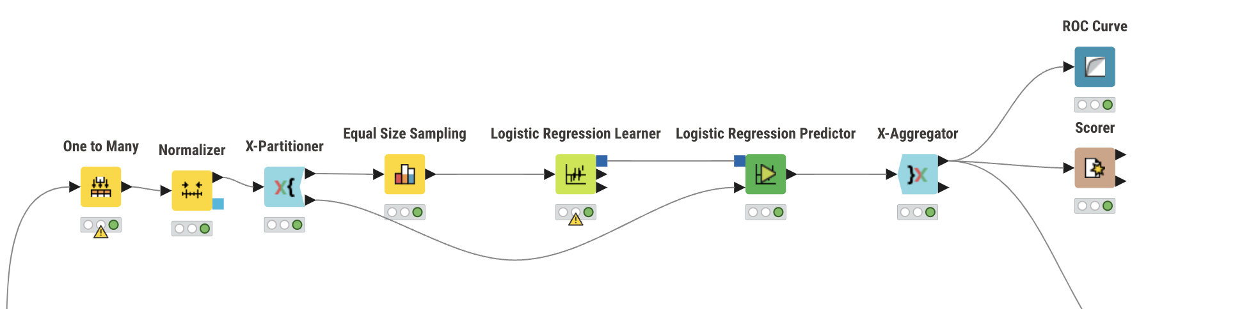
Model Workflow & Nodes
MODEL WORKFLOW & NODES
.
MLP
.
K-Nearest Neighbor
Logistic Regression Modeling Workflow in KNIME
The pipeline includes one-hot encoding, normalization, class balancing through equal size sampling, model training using Logistic Regression, and evaluation through cross-validation with ROC Curve and Scorer nodes.
19

Slide 20
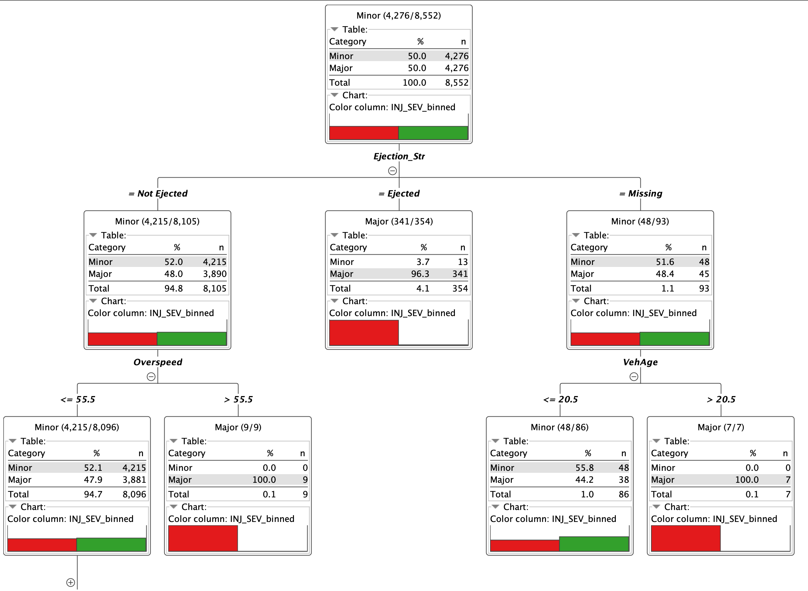
Decision Tree Levels
Decision Tree Levels
This decision tree shows how ejection status, overspeed, and vehicle age impact injury severity.
If a person is ejected, they are almost always severely injured.
If not ejected, high overspeed (over 55.5 mph) still leads to 100% major injuries.
When ejection data is missing, older vehicles (over 20.5 years) are again strongly linked to major injuries.
Overall, ejection and speed are the biggest red flags.
20

Slide 21
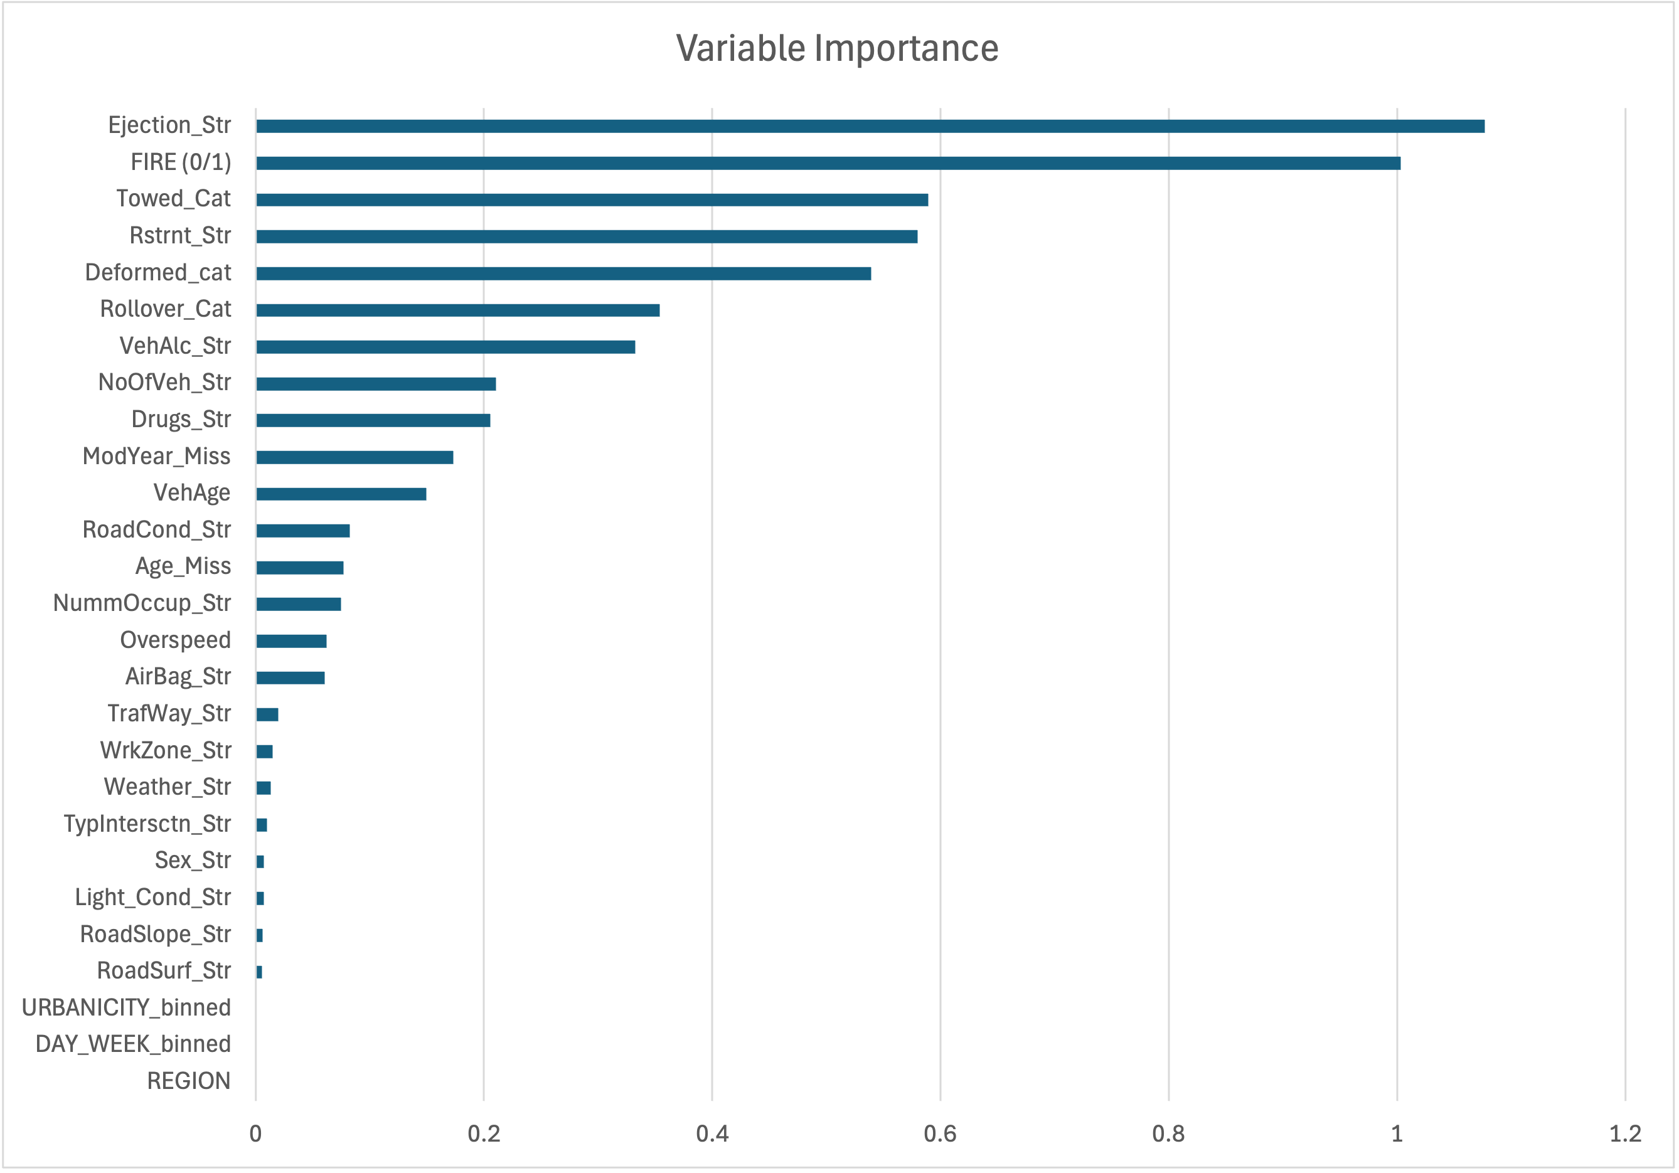
Key Predictors
Variable Importance
Ejection Status and Fire Occurrence: Top predictors, highlighting the critical role of crash dynamics in injury severity.
Restraint Use and Vehicle Damage: Seatbelt usage and damage extent significantly influence severity outcomes.
21

Slide 22

EVALUATION

Slide 23
Evaluation – Accuracy Table
Performance Metrics Comparisons
Model | Sensitivity | Specificity | Precision | Accuracy
Logistic Regression | 0.716 | 0.723 | 0.376 | 0.721
Gradient Boosting | 0.720 | 0.728 | 0.382 | 0.726
Random Forest | 0.681 | 0.742 | 0.382 | 0.731
K-Nearest Neighbors | 0.638 | 0.681 | 0.319 | 0.673
Multilayer Perceptron | 0.715 | 0.709 | 0.365 | 0.711
Decision Tree | 0.681 | 0.714 | 0.357 | 0.707
​
23

Slide 24
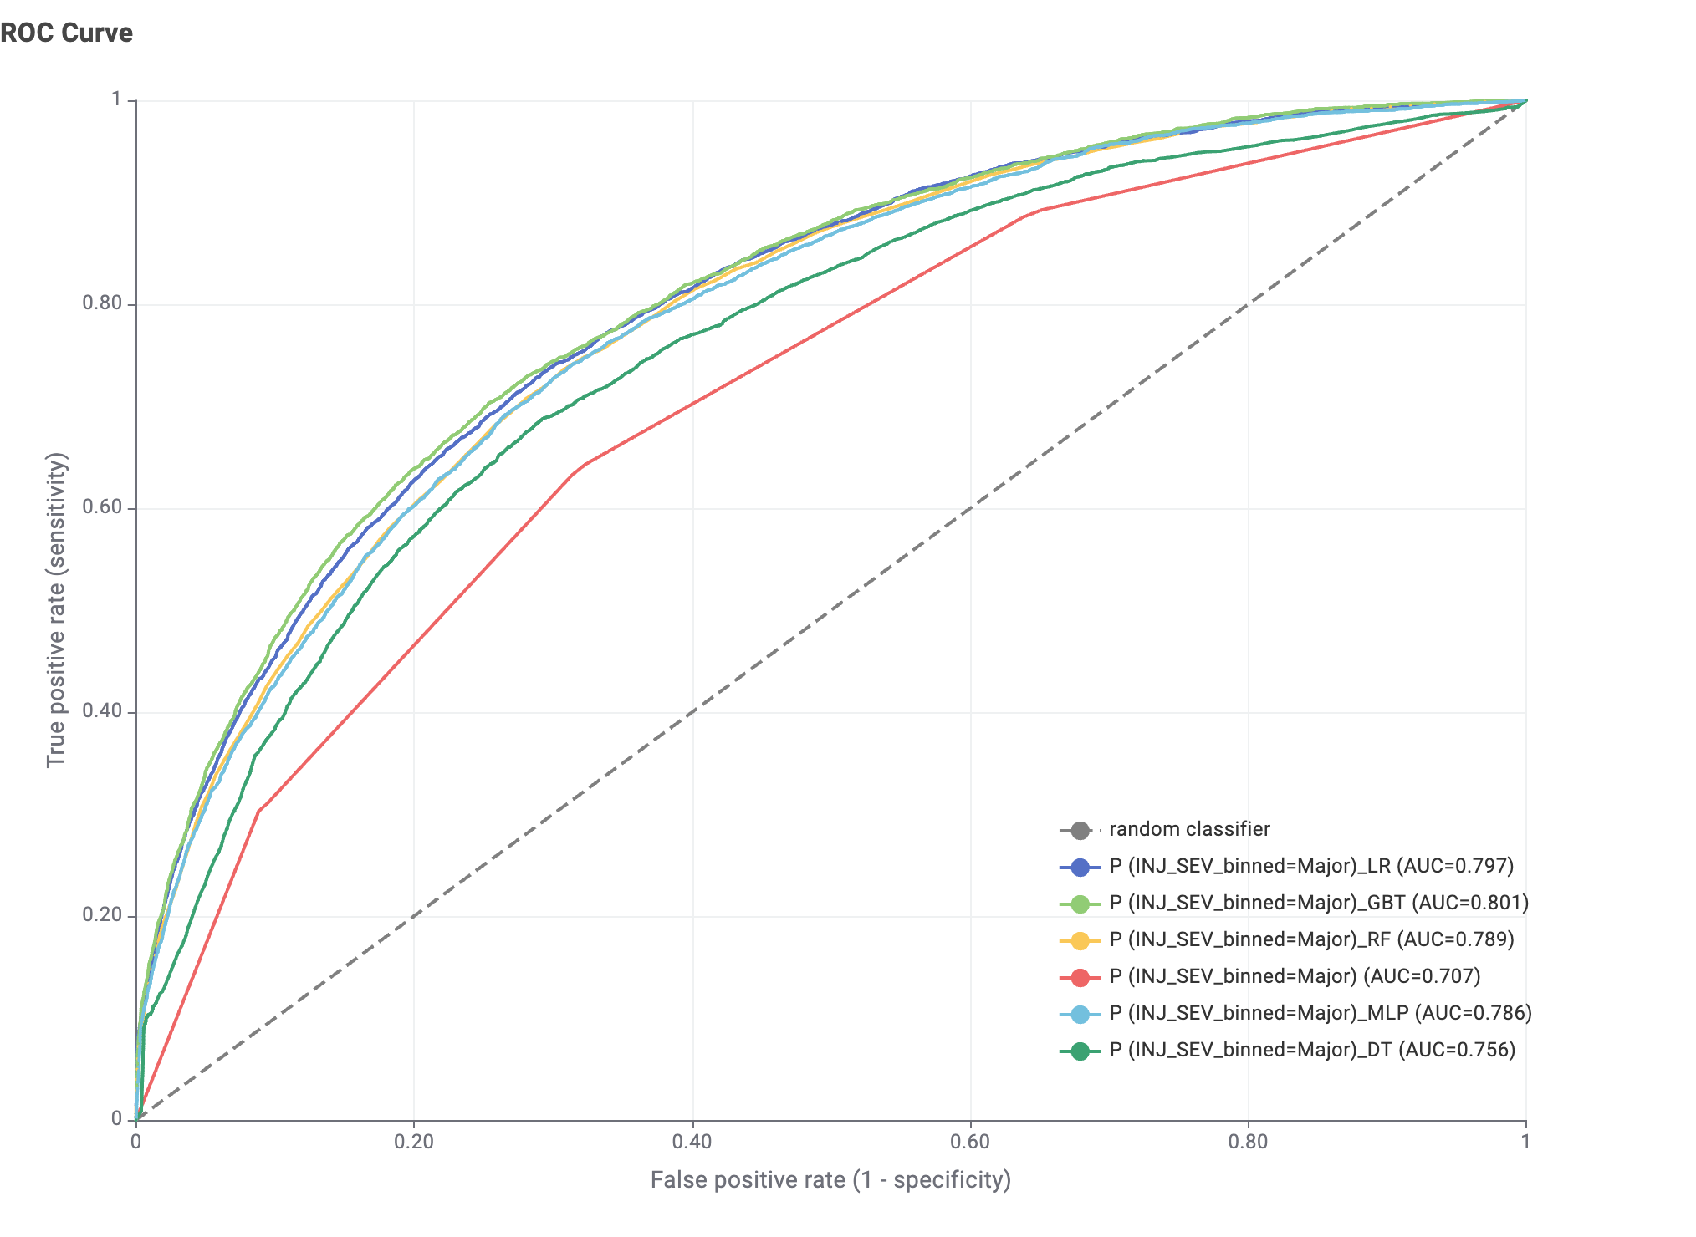
ROC Curves’ Comparisons
All models performed better than random guessing (diagonal line).
Gradient Boosted Trees (GBT) had the highest AUC at 0.801
Logistic Regression (LR) and Random Forest (RF) followed closely.
MLP and Decision Tree (DT) performed slightly lower but still reasonable.
Ensemble models (GBT, RF) captured injury patterns more effectively than standalone models.
Takeaway: GBT offers the best trade-off between sensitivity and specificity for predicting major injuries.
24

Slide 25



Model Performance Summary
Best Performing Models:
Gradient Boosting (AUC = 0.801)
Random Forest (Strong specificity)
Top Predictors:
Ejection
Restraint use
Fire occurrence
Vehicle damage
Summary:
Overall moderate success across models.
Opportunity to improve models through tuning.
25
23

Slide 26

DEPLOYMENT

Slide 27


Operational Applications and Integration
Applications:
DOT/NHTSA crash analytics platforms.
First responders (quick injury severity assessment).
Insurance companies (risk profiling).
Deployment Assets:
Complete KNIME workflow designed and documented.
27
25

Slide 28

CONCLUSION + SUMMARY

Slide 29


Key Takeaways and Future Work
Takeaways:
Predictive models moderately to strongly classify injury severity.
Crash-specific and vehicle-related factors are the key predictors.
Gradient Boosting and Random Forest showed the strongest performance.
Predictive analytics can support smarter safety policies and response strategies.
Future Directions:
Threshold tuning and optimization.
Model retraining with new data.
Feature expansion for improved model performance.
29
27

Slide 30
Thank You!

